Slide 1
A study on the modeling of the distribution automation systems using Petri Nets
Student: Huiyuan Xiao
Professor: Prof. Antonello Monti
Supervisor: Abhinav Sadu
Huiyuan Xiao

Slide 2
Motivation
Instantaneous change in state quantities
Volatility and randomness of new energy The difficulty of control increases
Active adjustment on the demand side
Higher penetration of DGs The number of controls increases
Centralized control Hierarchical control
Decentralized automation unit
(Substation Automation Units)

Slide 3
Motivation
With the higher penetration of distributed generations (DGs) and increase of the control complexity due to interaction of huge number of actors in smart grid, Distribution Automation (DA) system is needed in distribution level to enhance efficiency, reliability and quality of electric service.
Hierarchical and distributed control approach needs to be applied in DA system, which introduces the concept of substation automation.
How to abstract distribution automation system as an accurate and observable model then complete the performance analysis play significant roles for the further grid upgrade.

Slide 4
One sentence introduction
The objective of present thesis is to
employ different types of Petri Nets (SCPN,STPN)
with different tools (PIPE, ORIS)
in different layers (function layer, component layer)
for performance analysis (survivability, dependability)
of different distribution automation systems
(Centralized Automation system v.s. IDE4L system)
in Medium Voltage level
(primary substation automation unit(PSAU))
with different protection approaches
(Migration, Backup-strategy etc.)

Slide 5
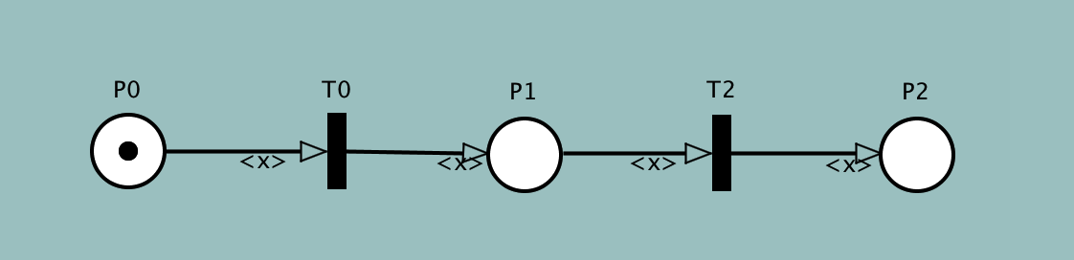
Petri Nets Basis
Petri net is a visual graphical mathematical modelling language to model static structure and dynamic change of Discrete Event Dynamic System (DEDS)
It is a structured description tool which is able to represent synchrony, synchronisation, and parallel logical relationships.
Place : a circle (P0,P1,92)
Transition: a rectangle (T0,T2)
Arc: a tangential arc between the place and the transition
Token: a dynamic object in the place (represented by a dot in the place P) that can be moved from one place to another

Slide 6
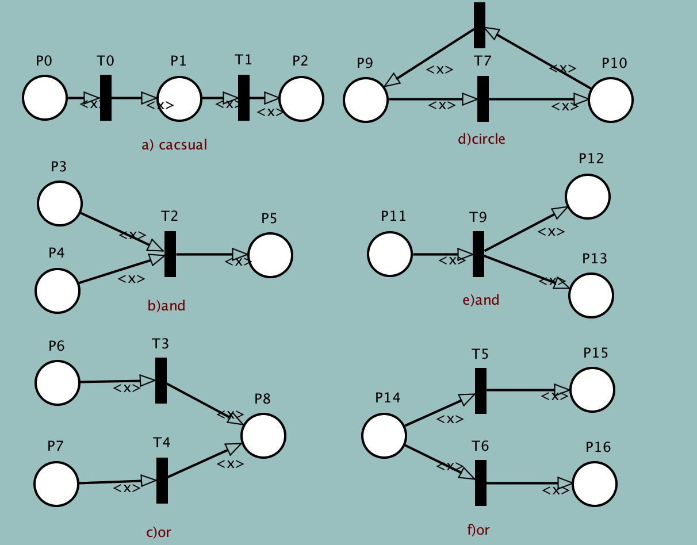
Petri Nets Properties and logic
Properties
Reachability
Boundness and safety
Liveness
Reversibility and home state
Basic logic connections
Basic logic connections represented by Petri Net

Slide 7
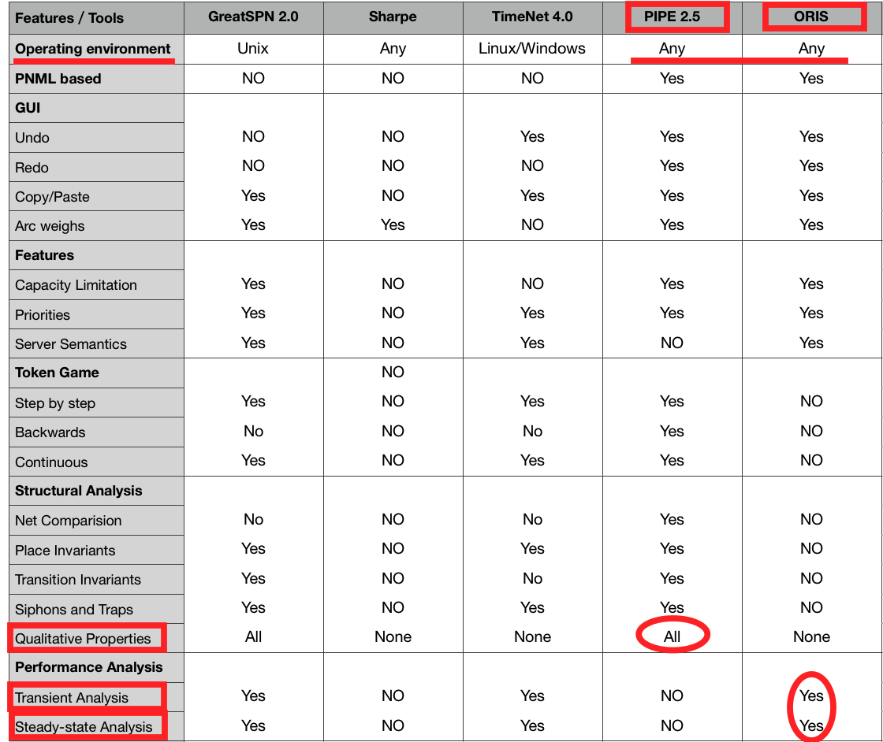
Petri Nets Tools
The different focusing aspects and different analysis needs of cases should be combined with the corresponding tool characteristics and personal preferences to complete the tool selection.
We choose PIPE and ORIS as simulation tools.

Slide 8
Petri Nets Types and characteristics
Petri net extensions
Vertical extension is from the basic P/T PN to advanced PN
(such as predicate / transition PN, colored PN).
Horizontal extension is from traditional Petri nets to Timed Petri nets(TPN) and Stochastic Petri Net (SPN or STPN) .
Stochastic Colour Petri Net (SCPN)
can define and identify different tokens in the same place, thus completing a more complex logical network architecture
PIPE is friendly for colored token definition
Stochastic Timed Petri Net (STPN)
transition may have time delay which is randomly chosen
ORIS has various functions for transient and steady-state analysis

Slide 9
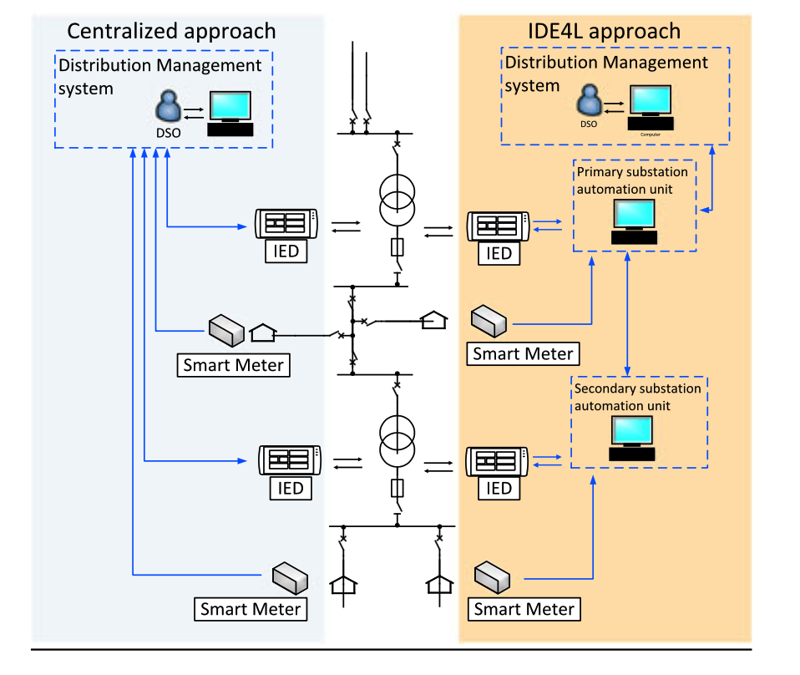
IDE4L project Automation concept and architecture
The IDE4L (Ideal Grid for All) project is funded by the 7th Framework Programm of the European Commission from September 2013 to August 2016, with a budget of €8M.
The aim of the project is to define,design and demonstrate “ideal grid for all”, an active distribution network which integrates Renewable Energy Sources (RESs) and new loads, and guarantees the reliability of classical distribution networks.
The automation architecture development of IDE4L is supported by two main concepts:
Use Case (UC) Methodology
Smart Grid Architecture Model (SGAM) framework
Characteristics:
Hierarchical and decentralized automation architecture
Modular distributed processing;
Reusable procedures.
Comparison between centralized and IDE4L approach.

Slide 10
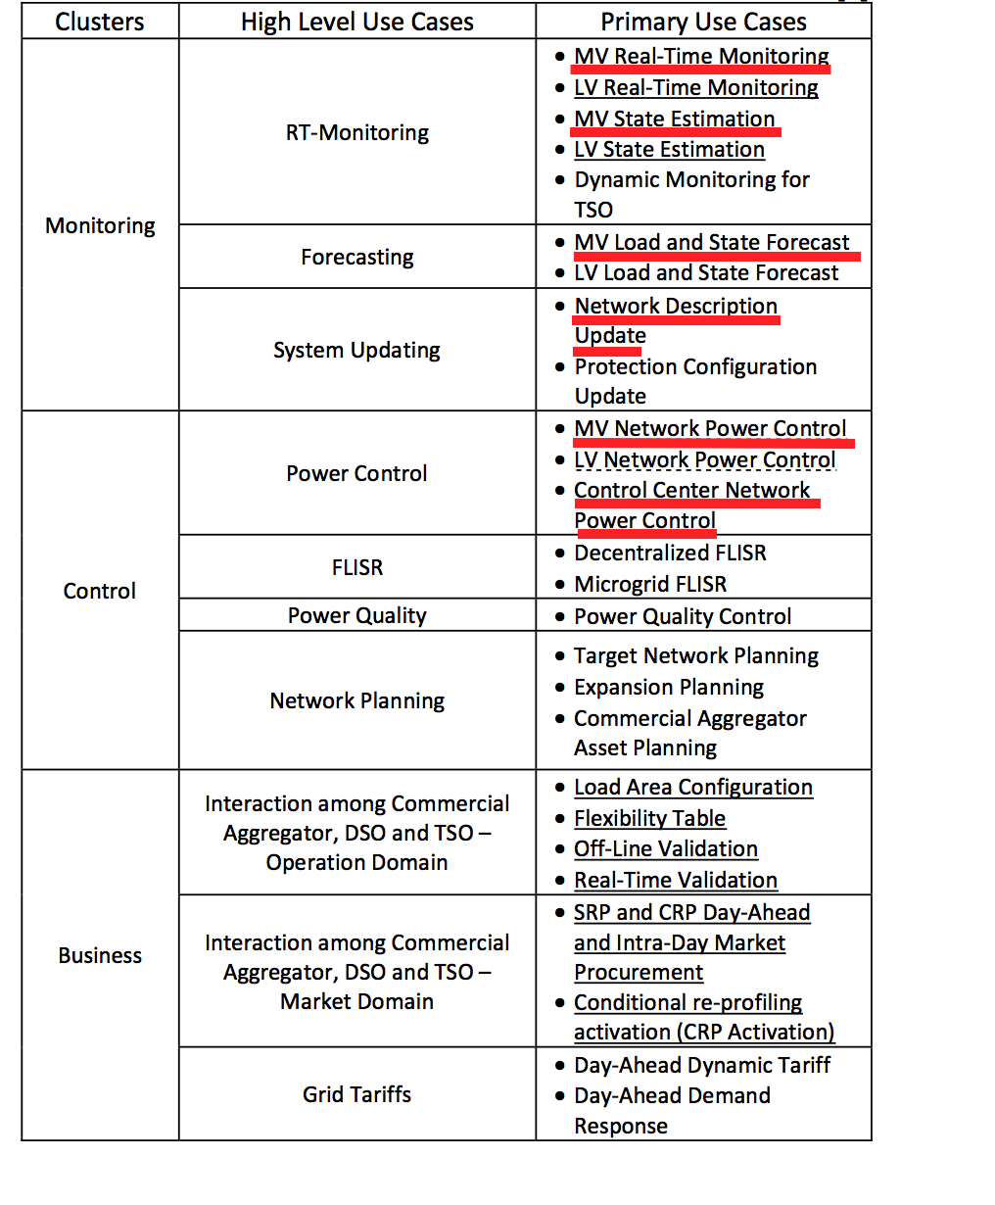
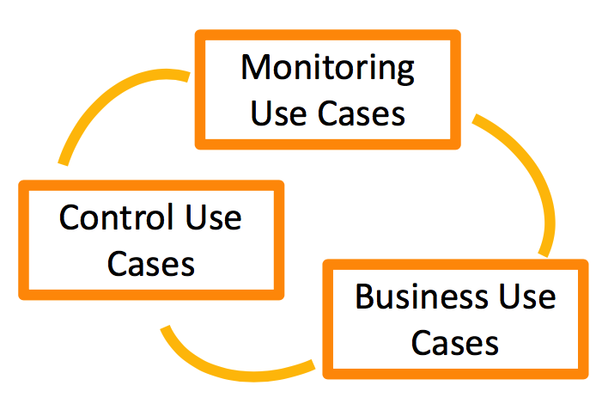
IDE4L project Use Case (UC) Methodology
We will focus on 6 major monitoring and control use cases in MV level in following analysis
MVPC,MVRTM,MVSE,MVSF,NDU,CCPC

Slide 11
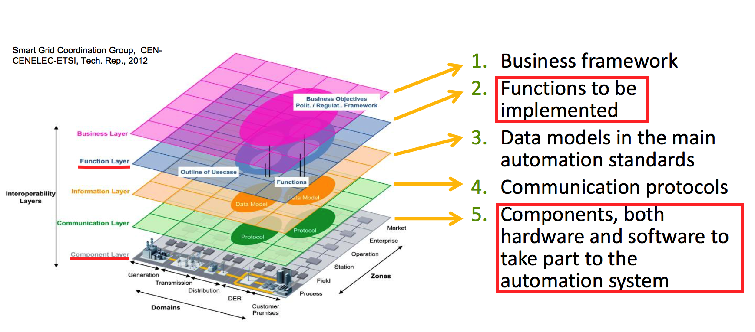
IDE4L project SGAM architecture
General description and link to Use Cases :
Function layer： Survivability analysis
Component layer：Dependability analysis

Slide 12
Performance analysis Concepts
Survivability is the ability of the target system to recover predefined operation state in a timely manner after the occurrence of disasters.
So we evaluate the impact of single physical components (actor) failure on overall system using SCPN through PIPE for Survivability Analysis.
Dependability is the capability of the target system to avoid service failures which may cause great losses more than is acceptable.
So we abstract the main failure modes from complex application scenarios then model the failure chain using STPN through ORIS simulation for Dependability Analysis.

Slide 13
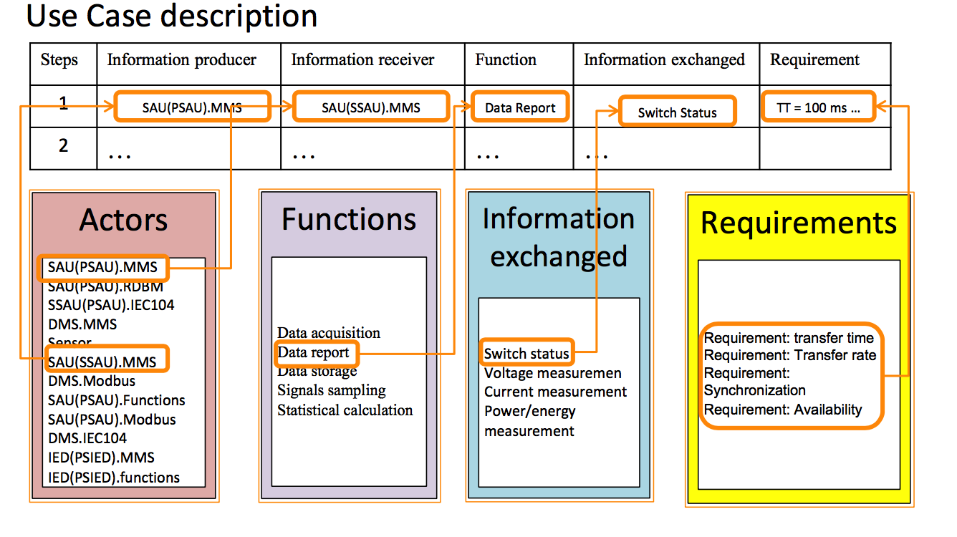
Performance analysis Survivability
actors —— places
functions —— transitions
information flow —— directional arc
different information or data sources —— different color tokens

Slide 14
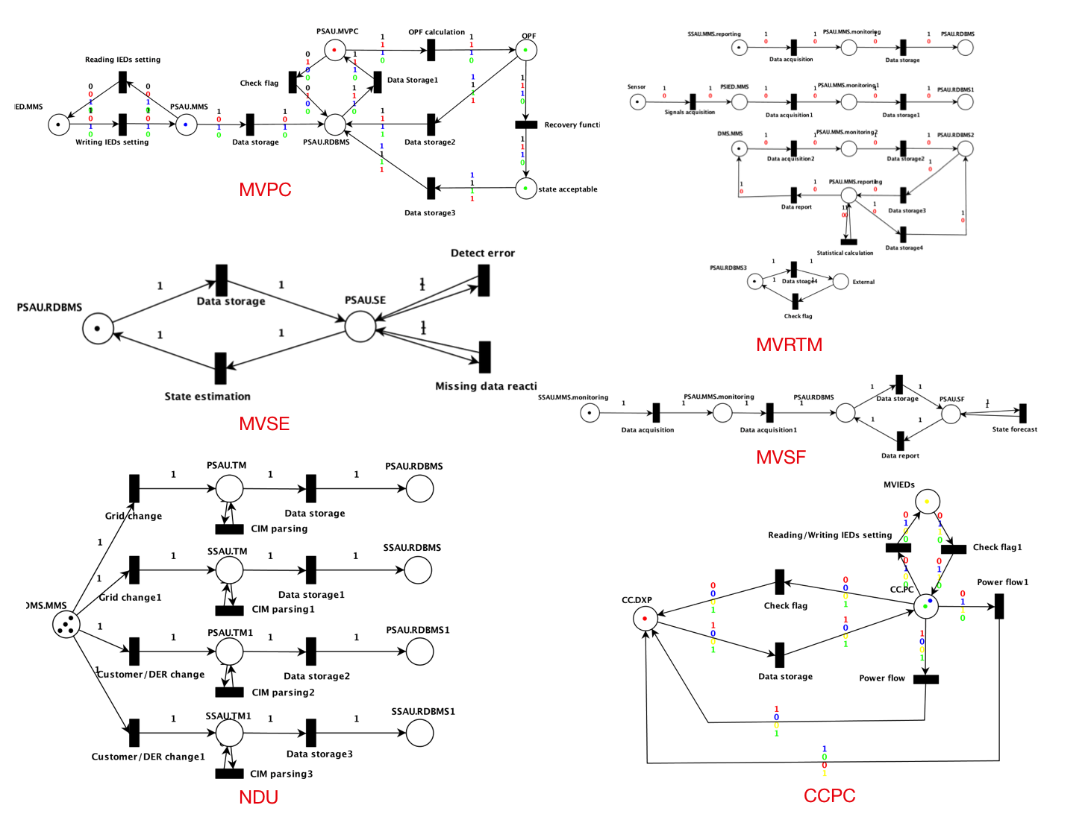
Performance analysis Survivability
MVPC,MVRTM,MVSE,MVSF,NDU,CCPC in PIPE

Slide 15
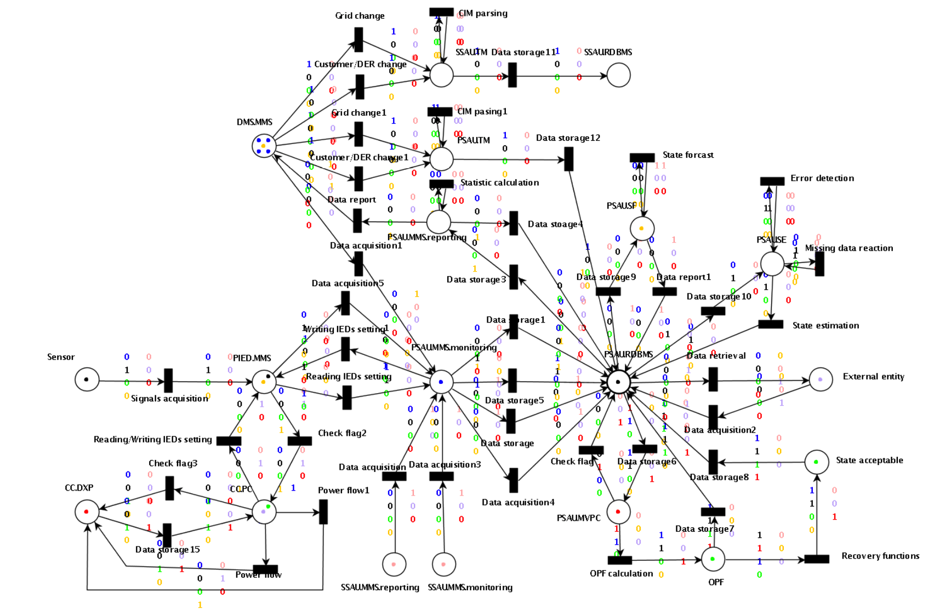
Performance analysis Survivability
MVPC,MVRTM,MVSE,MVSF,NDU,CCPC in PIPE(total)

Slide 16
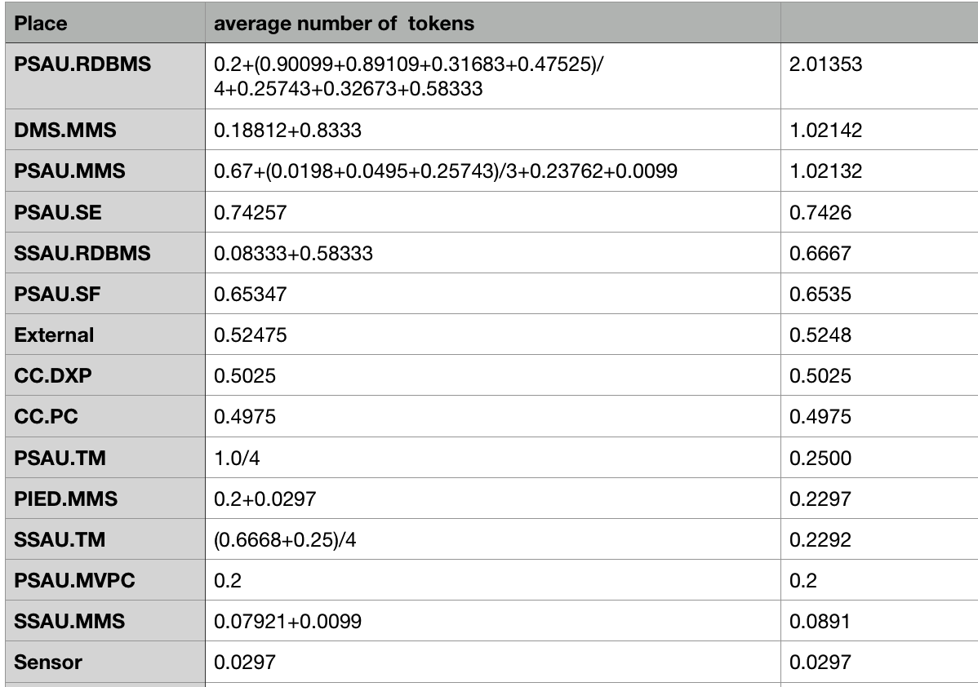
Qualitative analysis Survivability
In component level PSAU is the most important component
In function level PSAU.RDBMS(Relational database management system) has the greatest impact for survivability

Slide 17
Theoretical basis behind results
Centralized architecture (CA) :
Coordination takes place at the control center level, in the so-called Distribution Management System (DMS)
Centralized data risk
IDE4L automation distribution architecture：
Allocating the intelligence at each voltage level, PSAUs are responsible for the MV network and SSAUs address the need related to LV network
Reducing the DMS computational and communication burden thanks to the local data processing and control
Maintaining the possibility to coordinate the automation in a hierarchical way
A proper coordination among the SAUs and with the DMS guarantees effective monitoring and control functionalities within shorter time frames than CA approaches and with higher efficiency than the fully distributed architectures.

Slide 18
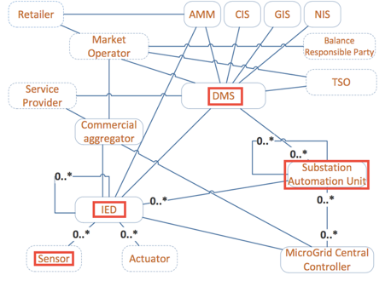
Performance analysis Dependability
For simplicity, in this section, we first assume one substation network equipped with only one Sensor, one IED, one PSAU, and one DMS server to demonstrate the dependability evaluation procedures.
Then discuss several approaches to improve the dependability

Slide 19
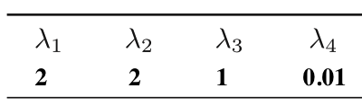
Performance analysis Setting
We separate Sensor, IED, PSAU and DMS into two states : normal operating mode (on) and failing down mode (down).
Here are 8 places corresponding to different states in STPN: Sensor_on, Sensor_down, IED_on, IED_down, PSAU_on, PSAU_down, DMS_on, DMS_down.
Three common ways for destroying the components: communication link failure, device physically breakdown and data corruption, which are separately denoted by transitions T_{CLF},T_{DC},T_{DPB}.PSAU has a particular cause of failure：database hacked denoted by T_{DH.}
The Firing Rates of Transitions

Slide 20
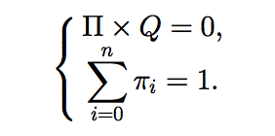

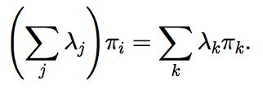
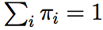
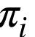
Performance analysis Calculation method of dependability
Calculation method of dependability for both steady-state and transient aspects involves two steps:
the analysis of the equivalent Continuous Time Markov Chain (CTMC)
and the computation of dependability
There are two equivalent methods to compute the steady-state probability of CTMC.
Specific mathematical calculations are very complex, fortunately ORIS's own performance analysis tools can quickly obtain analysis results (steady-state failure probability) both in data and graph.

Slide 21
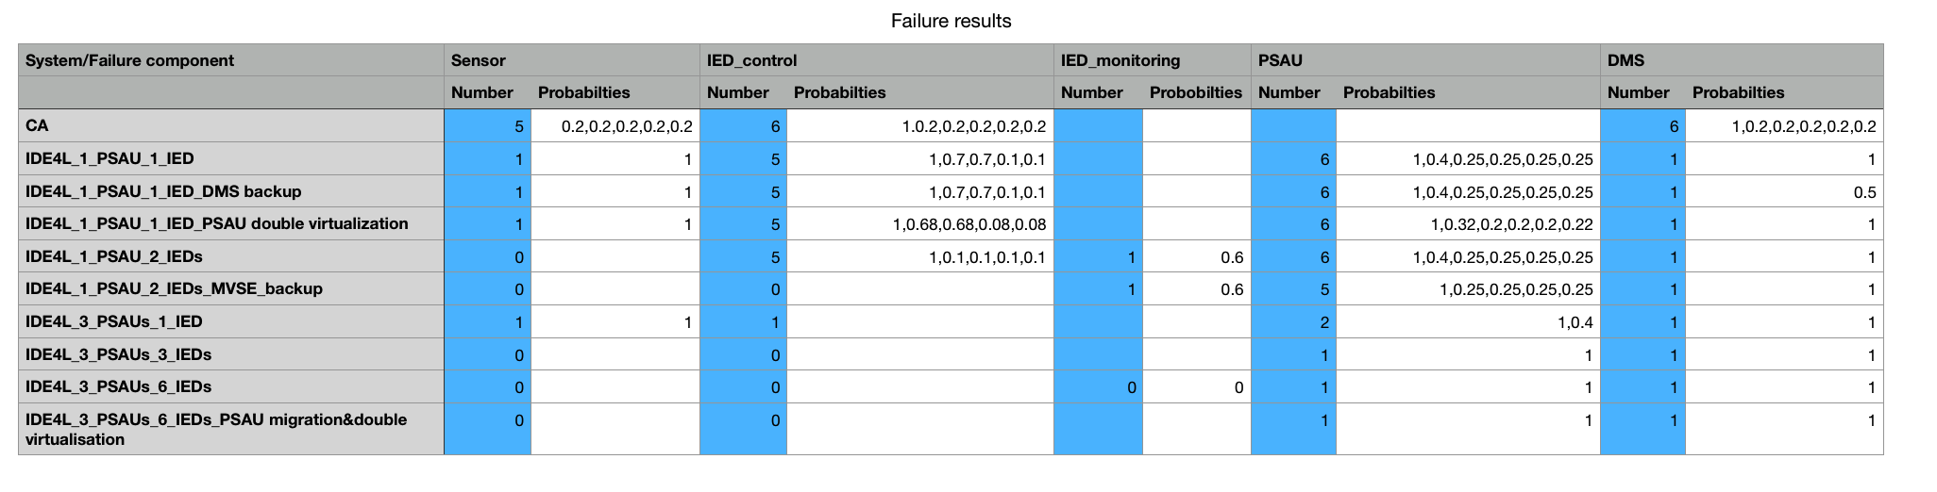
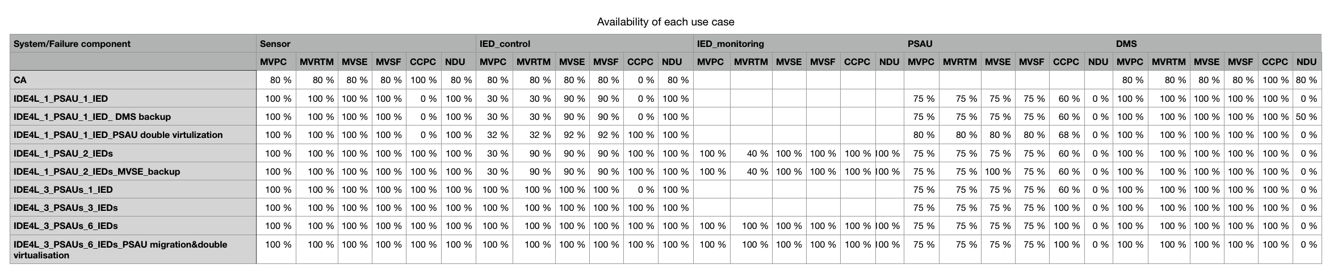
Protection approaches Dependability
The number of failure use cases marked by blue can easily indicate the rise in security.
Just an intuitive impression of all the data we can achieve from GSPN analysis function(timed transitions have exponential distributions, and immediate transitions have 0-Dirac distributions) , following we will present detailed comparative analysis corresponding to the specific model.

Slide 22
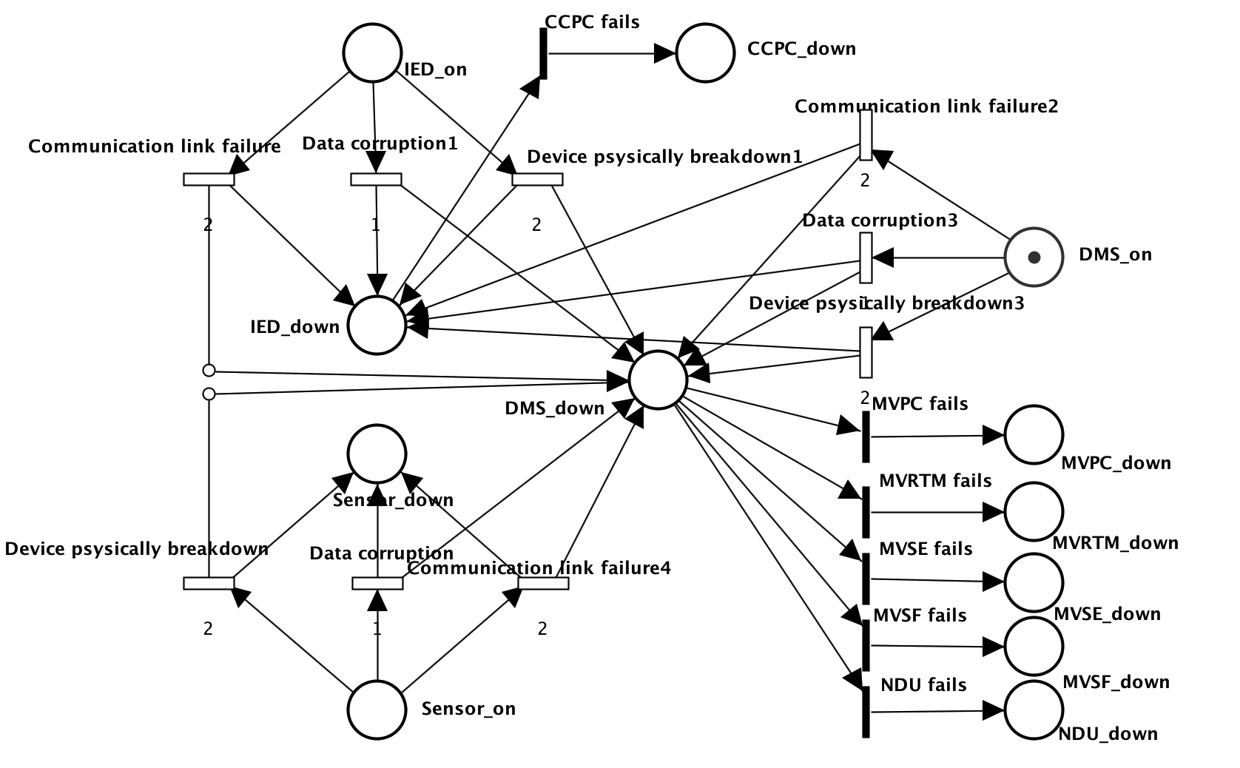
Performance analysis Centralized Automation(CA)
Centralized automation(CA) architecture
only one Sensor, one IED and one DMS

Slide 23
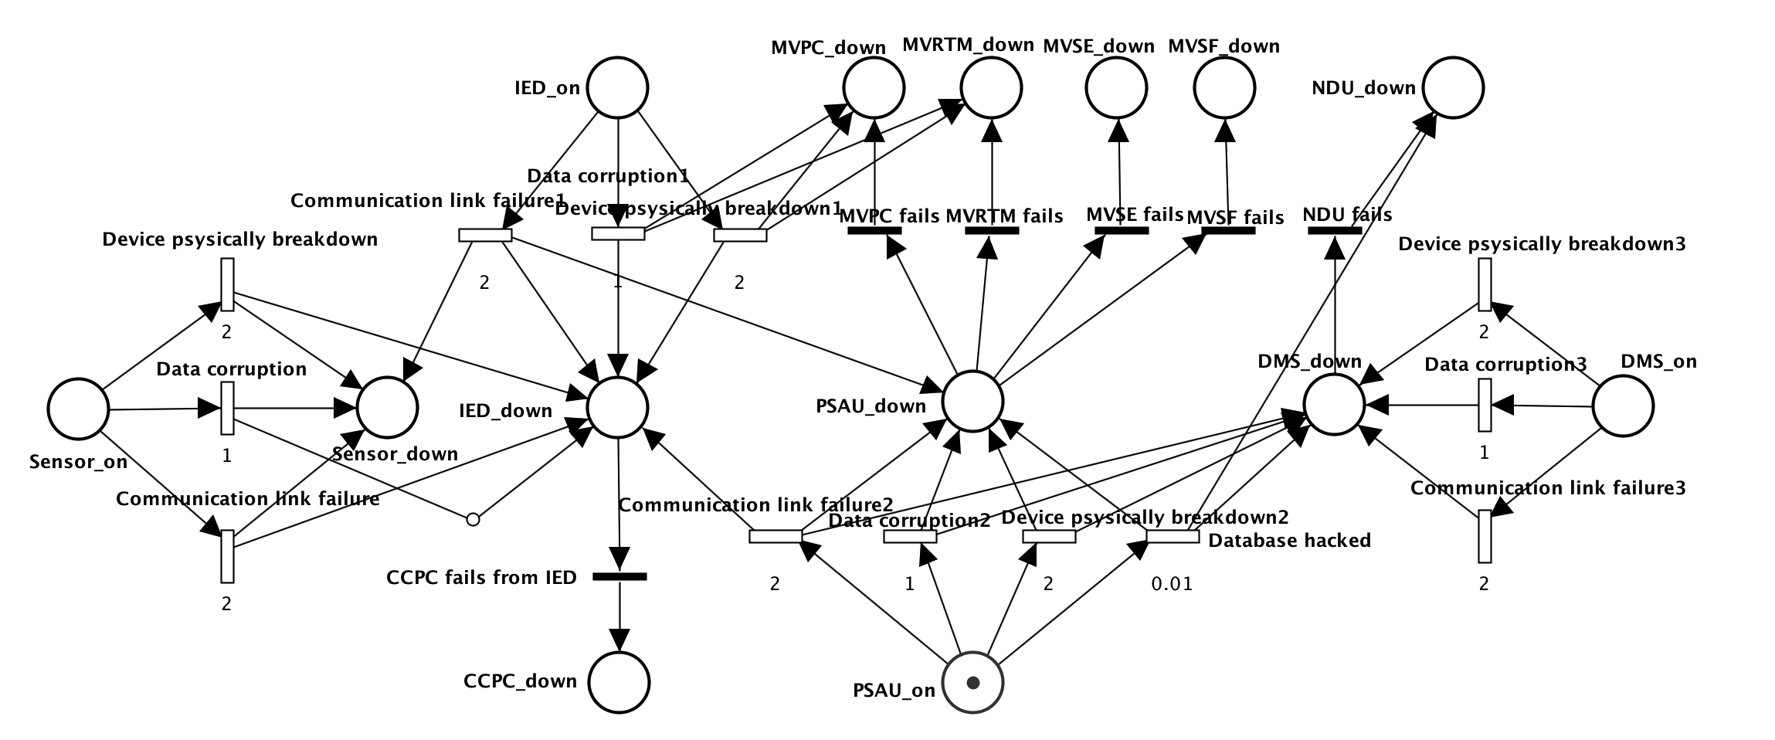
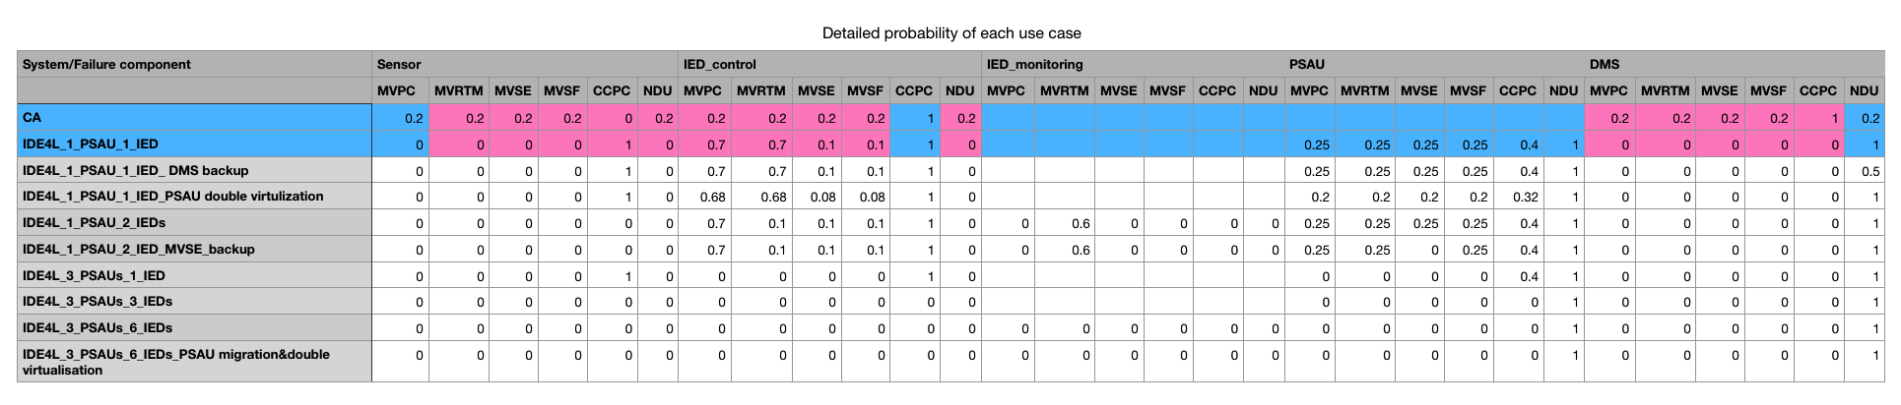
Performance analysis IDE4L
IDE4L architecture
only one Sensor, one IED, one PSAU and one DMS

Slide 24
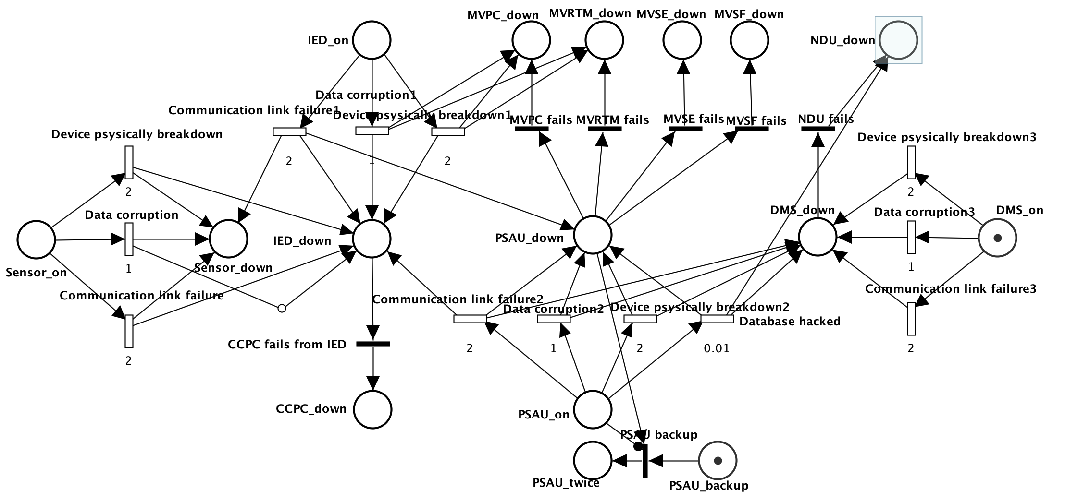
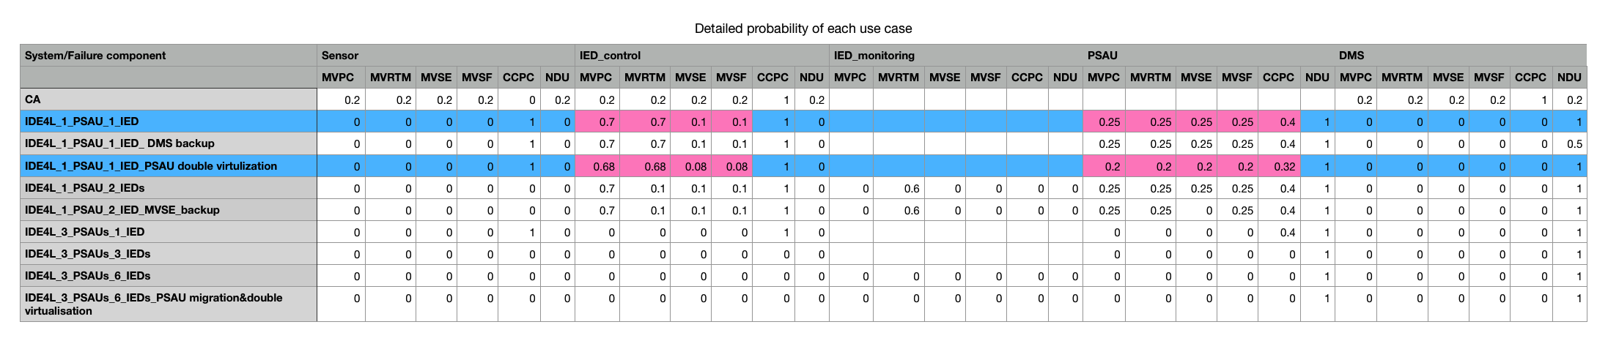
Protection approaches PSAU double virtualization
IDE4L automation distribution architecture with PSAU-double virtualization
One Sensor, one IED, one PSAU and one DMS
Double virtualization: The functional and data layers, which will contain functional and data entities, will be logically separated.

Slide 25
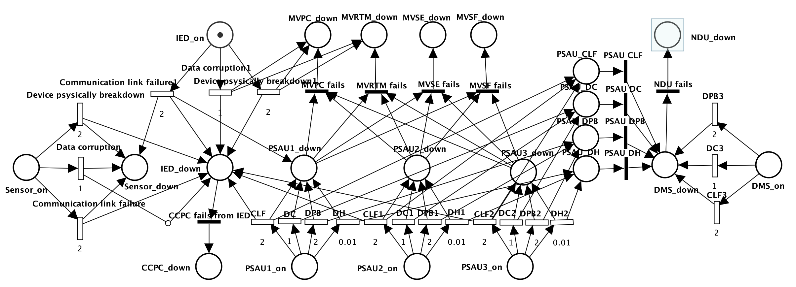
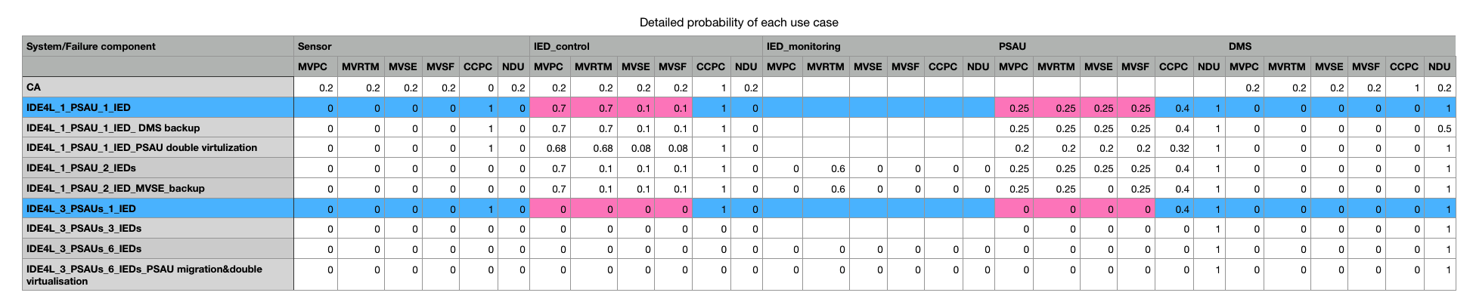
Protection approaches PSAU migration
IDE4L automation distribution architecture with PSAU migration
one Sensor, one IED, three PSAUs and one DMS

Slide 26
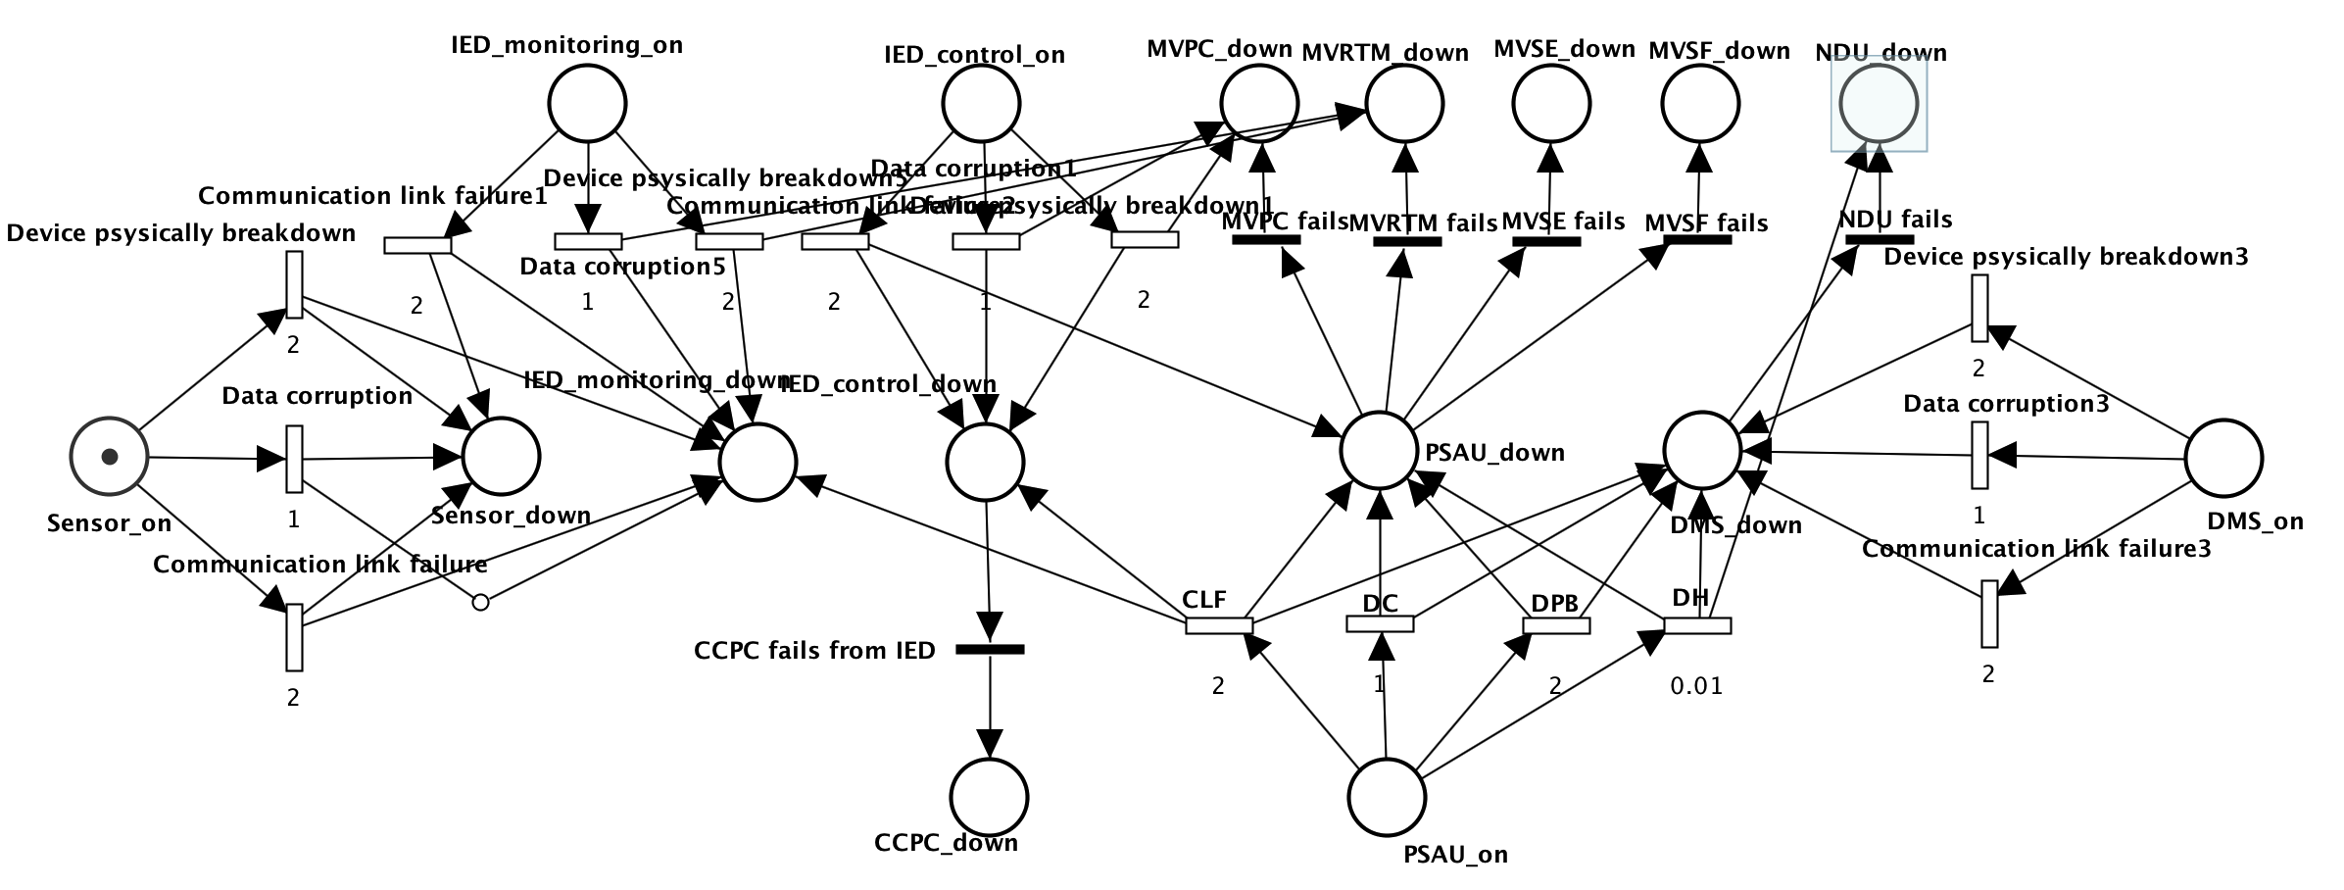
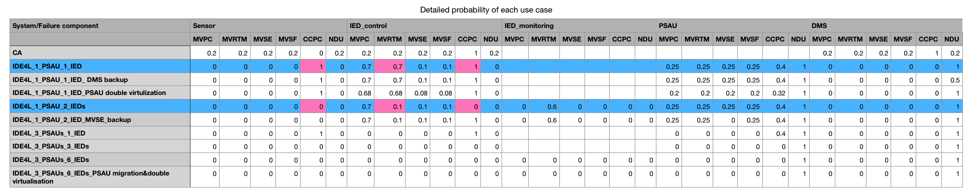
Protection approaches IED separation
IDE4L automation distribution architecture with separated IEDs
one Sensor, two IEDs(monitoring, control), one PSAU and one DMS

Slide 27
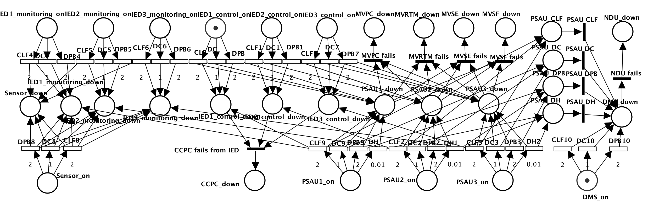
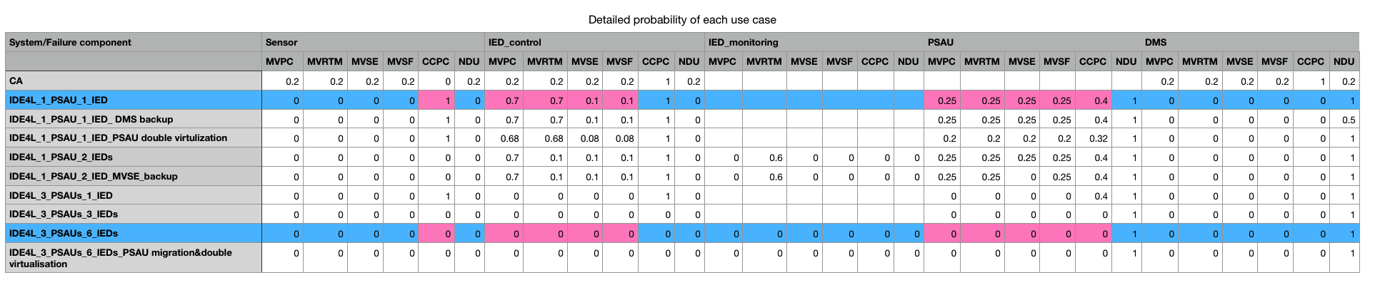
Protection approaches IED separation & PSAU migration
IDE4L automation distribution architecture with PSAU migration and separated IEDs
one Sensor, six IEDs, three PSAUs and one DMS

Slide 28
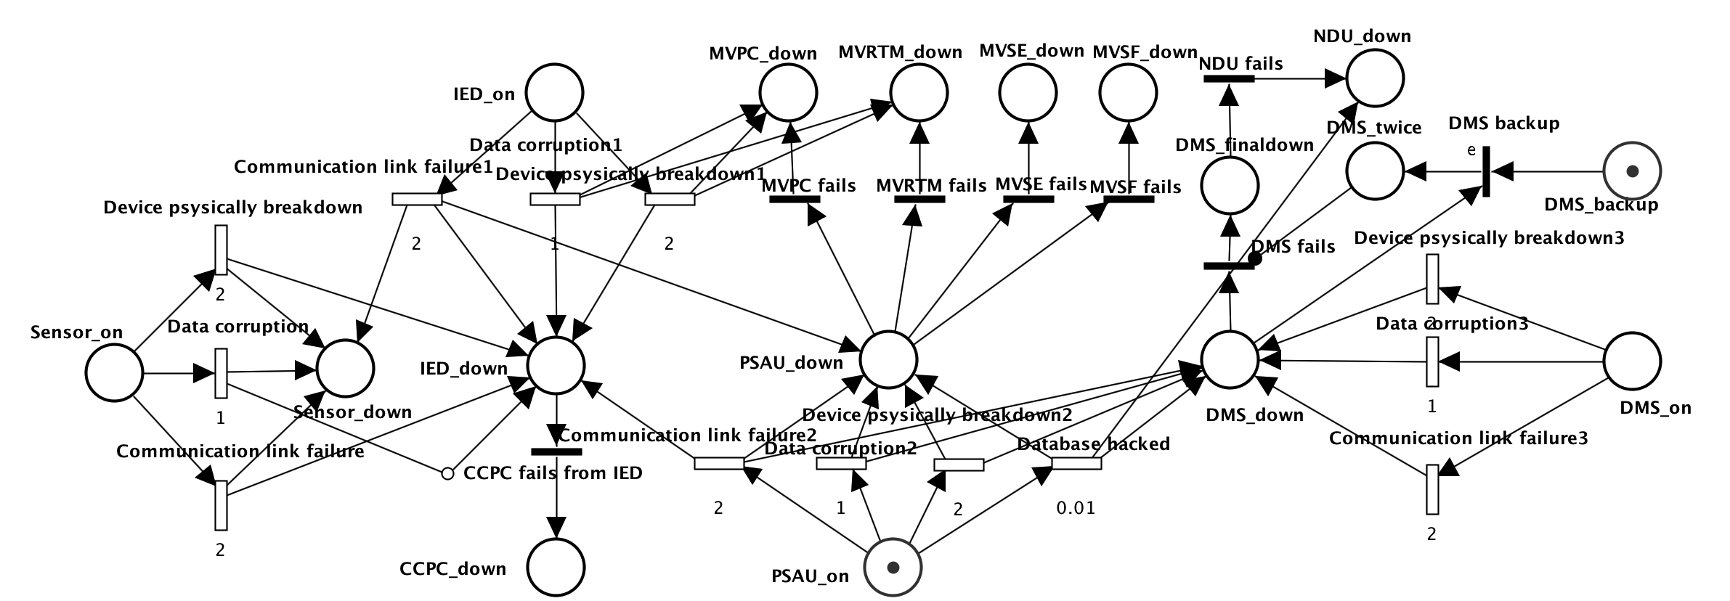
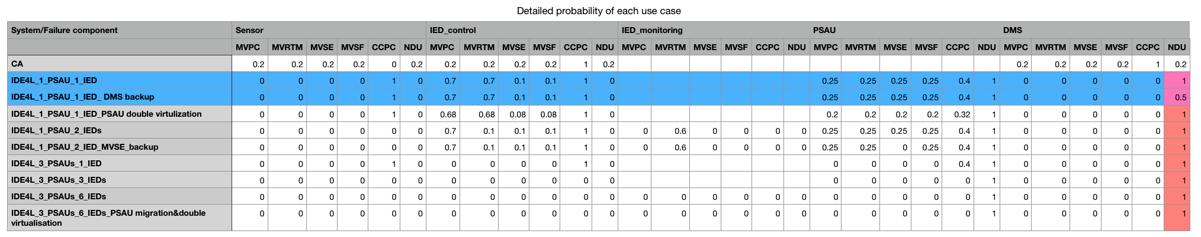
Protection approaches DMS-backup strategy
IDE4L automation distribution architecture with DMS-backup strategy
one Sensor, one IED, one PSAU and one DMS with Backup strategy

Slide 29
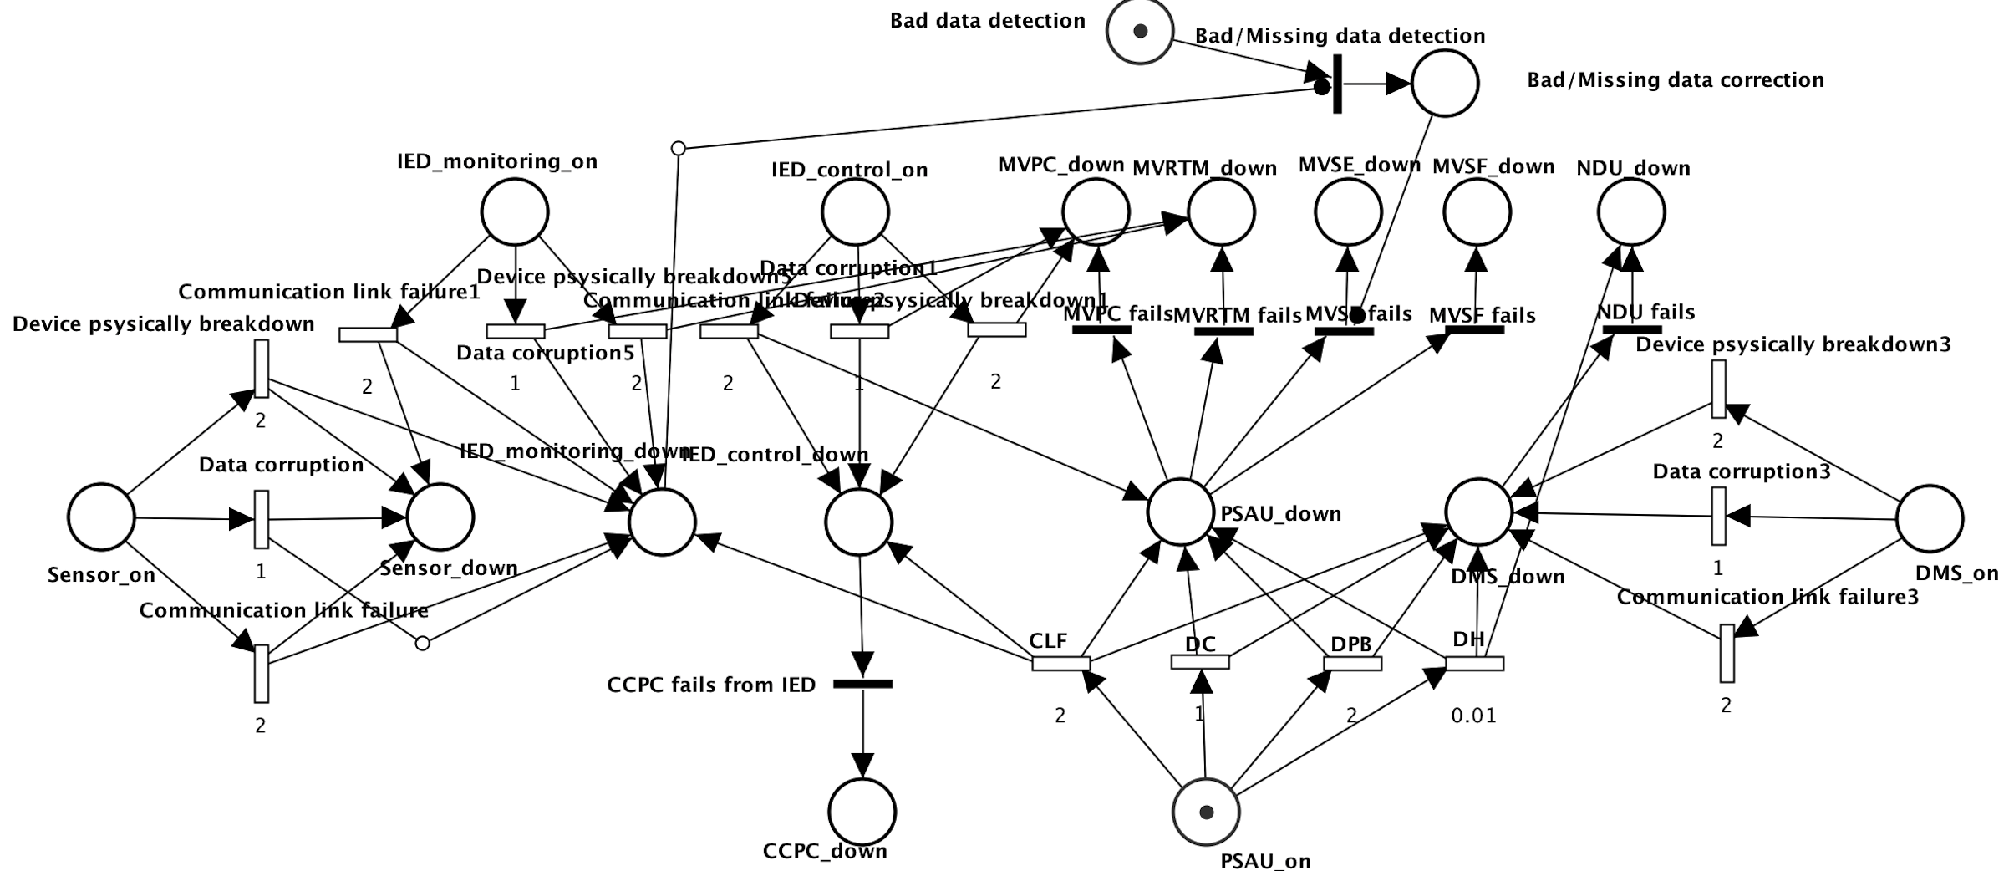
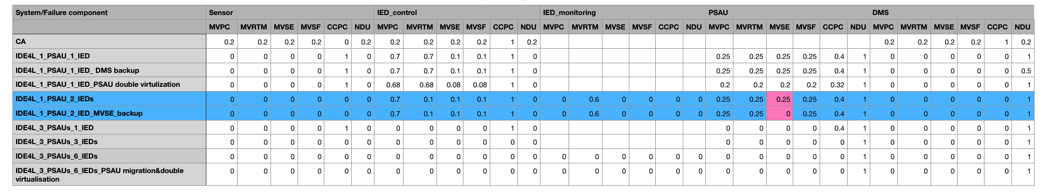
Protection approaches Bad/Missing data detection/correction
IDE4L automation distribution architecture with Bad/Missing data detection/correction
One Sensor, two separated IEDs, one PSAU and one DMS

Slide 30
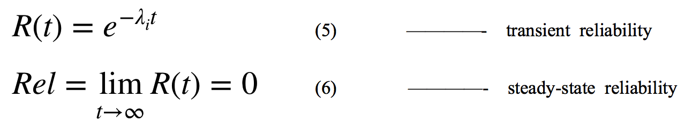
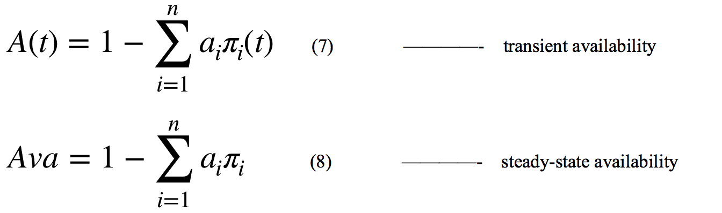
Performance analysis KPI: Key Performance Indicator
1.Reliability
the capability of each component to continuously provide services without failures.
2.Availability:
the resilience of correct services for some critical components.

Slide 31
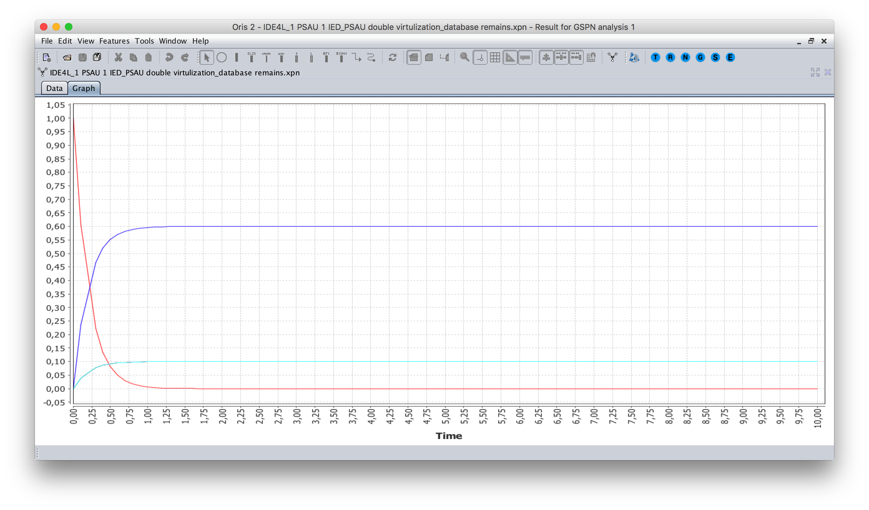
KPI Availability
Transient period is very short (less than 1s).
Using steady state availability as the KPI.

Slide 32
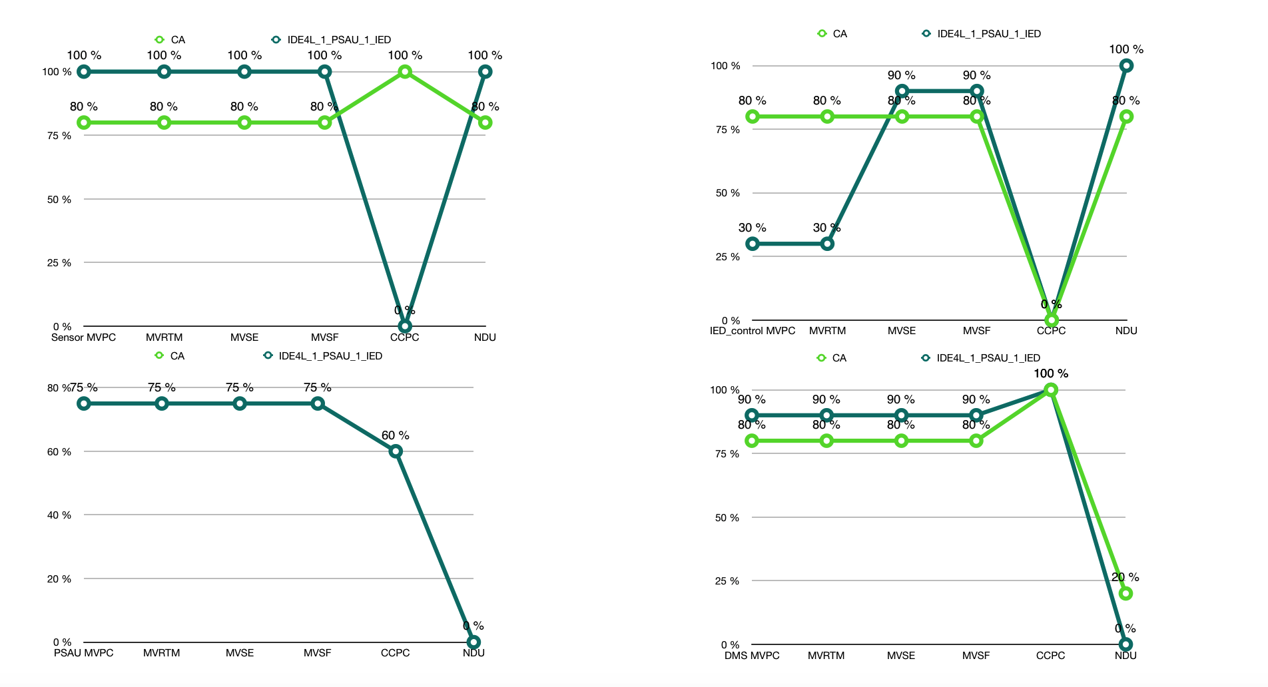
KPI Availability
Compared with centralized automation,IDE4L significantly improve the availability of most use cases.
Availability of a few use cases decrease, which can be avoided through following protection approaches.

Slide 33
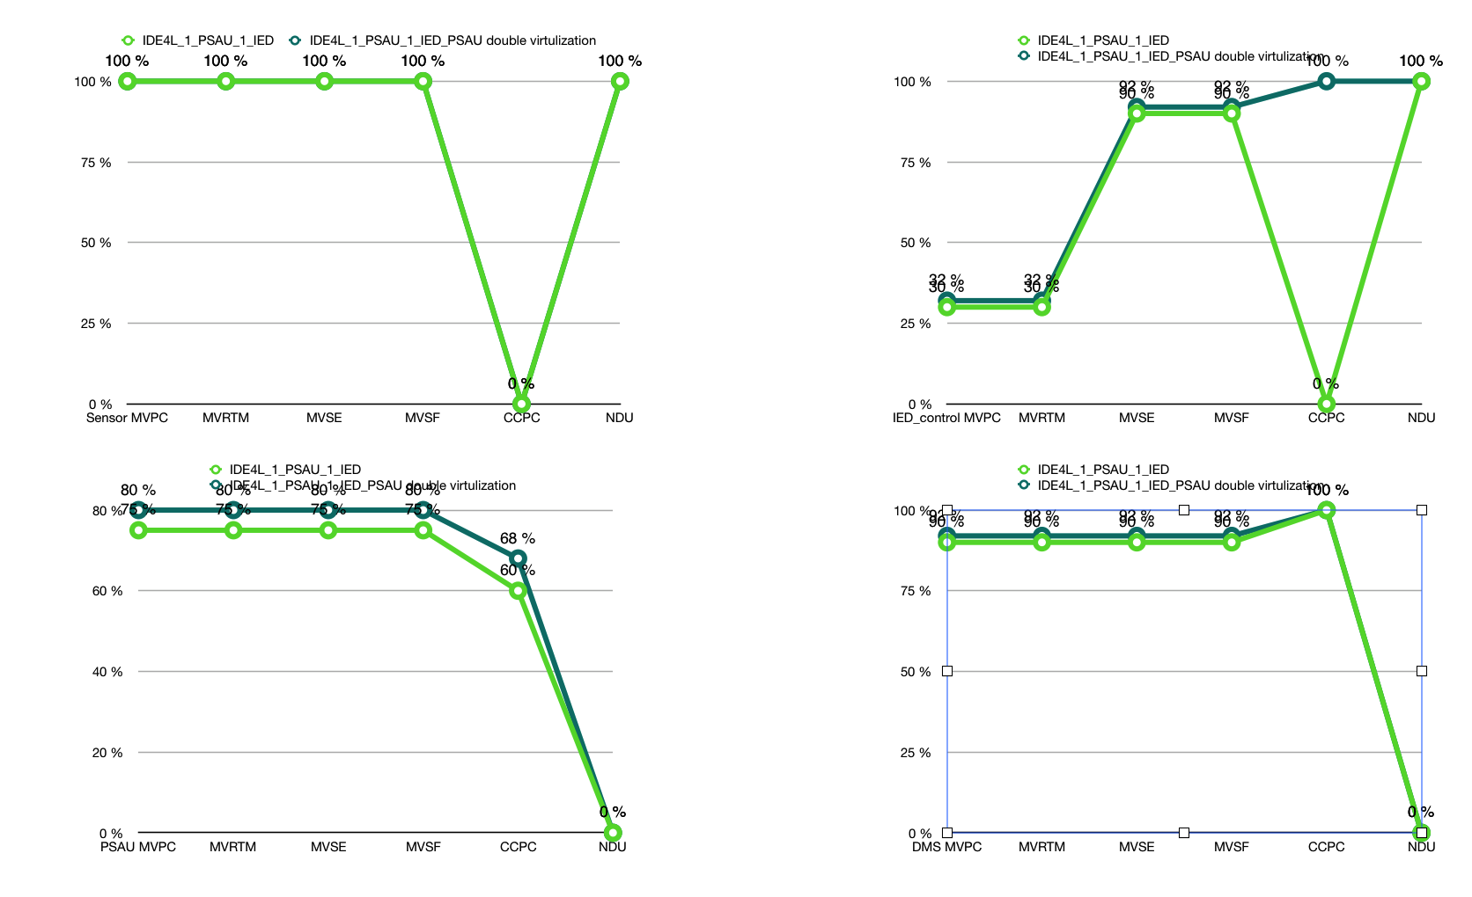
KPI Availability
PSAU double virtualization can slightly decrease risks of MVPC, MVRTM, MVSE,MVSF in case of IED,PSAU and DMS failures.

Slide 34
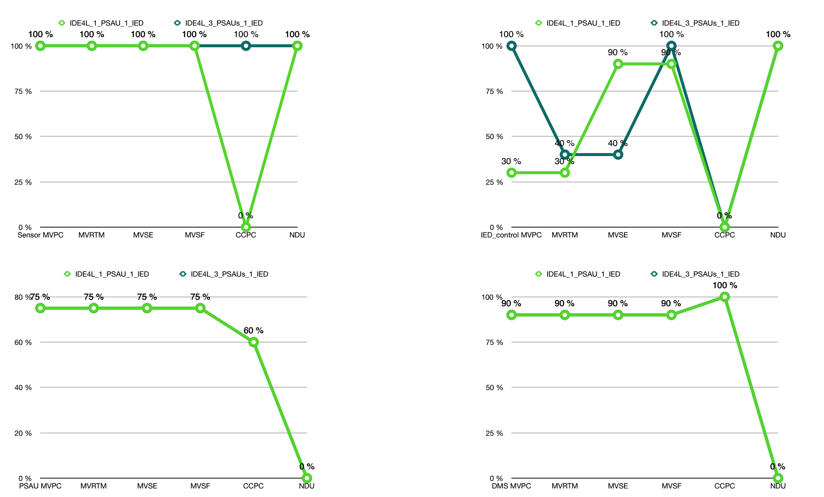
KPI Availability
PSAU migration is the most powerful means of protection, with a strong protective effect all use cases of IED and PSAU.

Slide 35
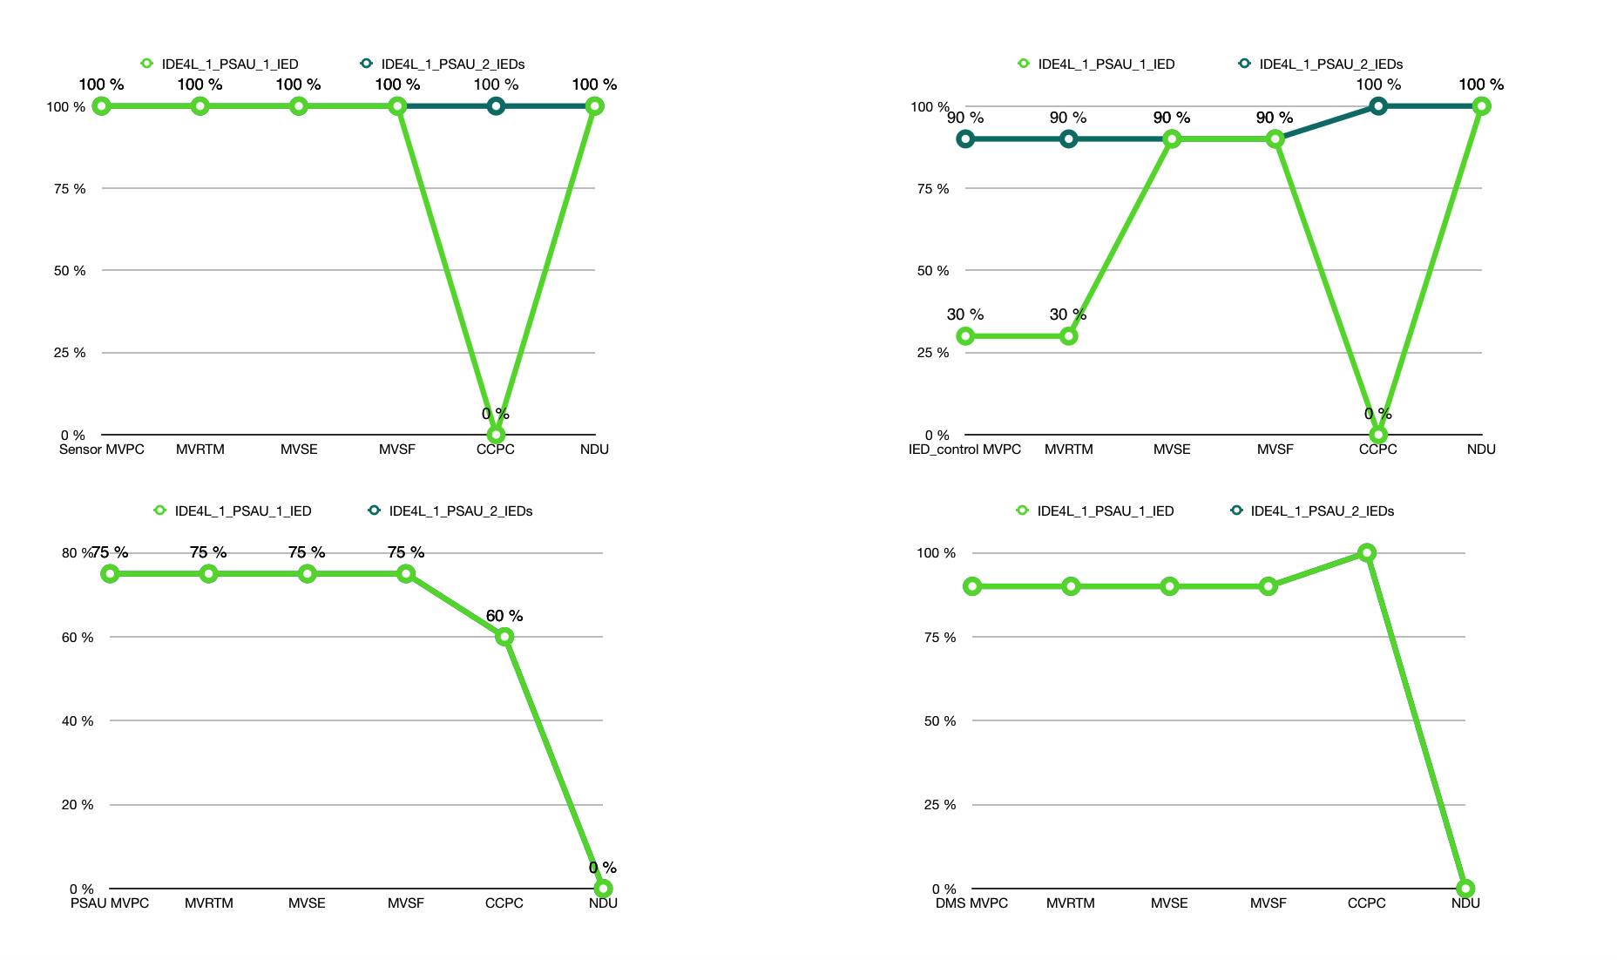
KPI Availability
The functional separation on IED can significantly improve the reliability of sensor, especially for CCPC. But the PSAU migration can also play the same role.

Slide 36
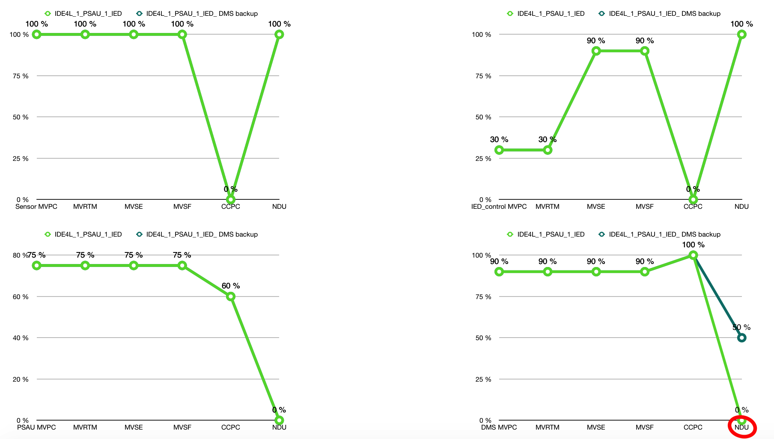
KPI Availability
DMS backup strategy is most targeted for the protection of DMS，especially irreplaceable for NDU.

Slide 37
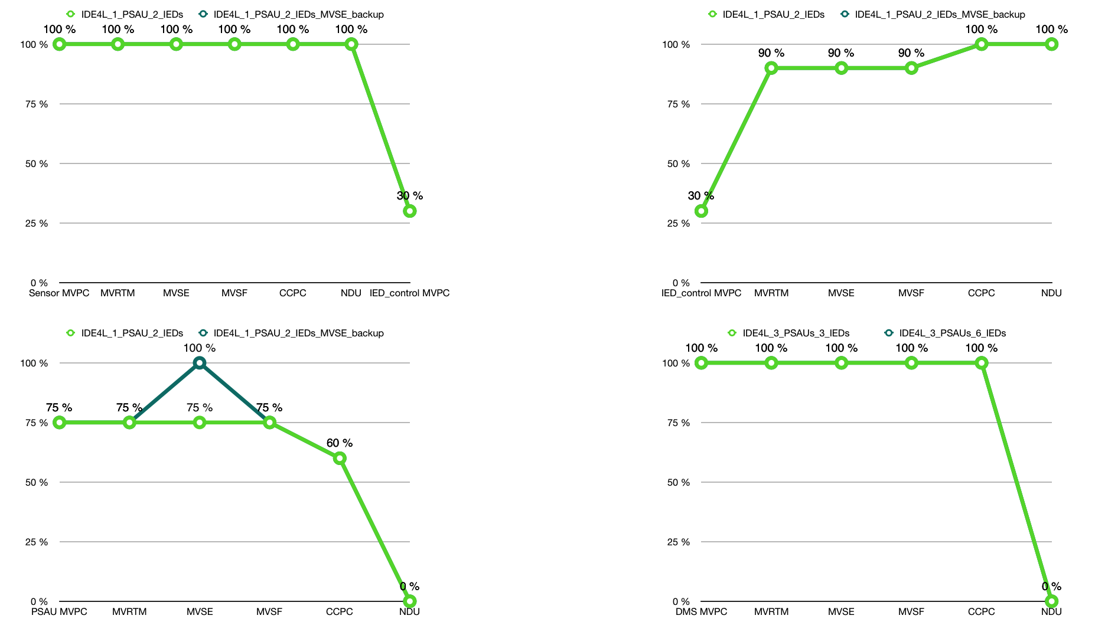
KPI Availability
Bad/Missing data detection/correction mainly protects MVSE.

Slide 38
Conclusion
This thesis is a feasibility study on using Petri Net theory for modeling and analyzing the distribution automation system
The feasibility and correctness of the proposed method are illustrated by a detailed study of the 6 major use cases at the MV level of IDE4L
The performance comparison of different architectures and protection approaches verify the advantages and necessity of the IDE4L system and the possibility of improvement. The analysis method can also be implemented in other system architecture.
The future work can focus on better protection methods for the core components, detailed transition procedure modeling and avoidance of the state space explosion problem that may occur in the calculation process.

Slide 39
Thanks for your attention!
Any question?
Contact
E.ON Energy Research Center
Mathieustraße 10
52074 Aachen
Germany
Huiyuan Xiao
T +49 17681596277
Huiyuan.Xiao@eonerc.rwth-aachen.de

